Slide 1
.Net Framework
BTC-704
Module-1,L-2

Slide 2
.Net Architecture
.NET architecture is:
  multi-language
  cross-platform
  based on the CLR, FCL, and JIT technology
  .NET components are packaged as assemblies

Slide 3
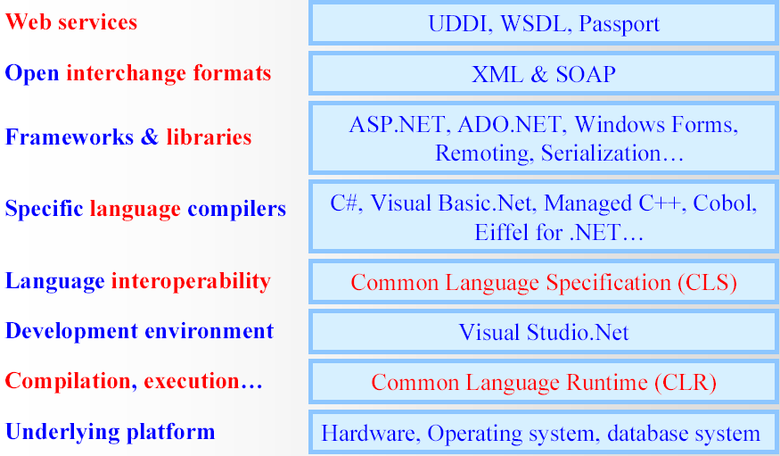
.Net Architecture

Slide 4
.Net Technical Architecture
VB
C++
C#
JScript
…
Visual Studio.NET
Common Language Specification
ASP.NET: Web Services
and Web Forms
Windows
Forms
Windows
Forms
ADO.NET: Data and XML
Base Class Library
Common Language Runtime

Slide 5
Common Language Runtime
A common runtime for all .NET languages
  Common type system
  Common metadata
  Intermediate Language (IL) to native code compilers
  Memory allocation and garbage collection
  Code execution and security
Over 15 languages supported today
  C#, VB, Jscript, Visual C++ from Microsoft
  Perl, Python, Smalltalk, Cobol, Haskell, Mercury, Eiffel, Oberon, Oz, Pascal, APL, CAML, Scheme, etc.
Rational is working on Java compiler for CLR

Slide 6
The CLR Architecture
Base Class Library Support
Thread Support
COM Marshaler
Type Checker
Exception Manager
Security Engine
Debug Engine
MSIL to Native
Compilers (JIT)
Code
Manager
Garbage
Collector (GC)
Class Loader

Slide 7
CLR Execution Model (Narrow)
Code in VB.NET
Code in C#
Code in another
.NET Language
VB.NET compiler
C# compiler
Appropriate
Compiler
IL(Intermediate
Language) code
CLR just-in-time
execution

Slide 8
CLR Execution Model
Source code
VB
C#
C++
Unmanaged
Component
Compiler
Compiler
Compiler
Managed
code
Assembly
IL Code
Assembly
IL Code
Assembly
IL Code
Common Language Runtime
JIT Compiler
Native Code
Operating System Services

Slide 9
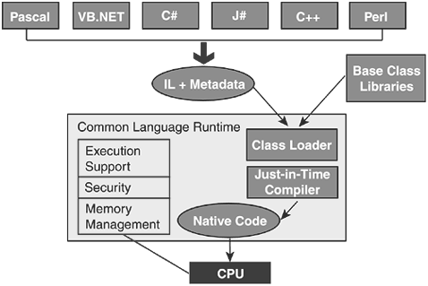
How CLR works?

Slide 10
CLR based execution
APP.exe
OS Process
CLR
JIT Compiler
other FCL components
Core FCL
obj code
Underlying OS and HW

Slide 11
Common Language Runtime
Execution Engine
  Compiles Microsoft Intermediate Language (MSIL) into native code
  Handles garbage collection
  Handles exceptions
  Enforces code access security
  Handles verification
    Managed v. Unmanaged

Slide 12
Implications of CLR execution model
Clients need CLR & FCL to run .NET apps
  available via Redistributable .NET Framework
Design trade-off…
  managed execution (memory protection, verifiable code, etc.)
  portability:
  slower execution?

Slide 13
CLR and JIT compiling.
Indirect execution of .Net applications.
All .NET languages compile to the same CIL.
The CLR transforms the CIL to assembly instructions for a particular hardware architecture.
  This is termed jit’ing or Just-in-time compiling.
  Some initial performance cost, but the jitted code is cached for further execution.
  The CLR can target the specific architecture in which the code is executing, so some performance gains are possible.

Slide 14
Advantages of CLR
Support for developer services (debugging)
Interoperation between managed code and unmanaged code (COM, DLLs).
Managed code environment
Improved memory handling
Improved “garbage collection”

Slide 15
Advantages of CLR
JIT allows code to run in a protected environment as managed code.
JIT allows the IL code to be hardware independent.
CLR also allows for enforcement of code access security.
Verification of type safety.
Access to Metadata (enhanced Type Information)

Slide 16
Before .NET
Windows GUI development: Win32 API, MFC, Visual Basic, COM
Web development: ASP
Java – “Write once, run anywhere.”
Embrace and extend: Visual J++

Slide 17
Life As a C/Win32 API Programmer
Traditional software development for the Windows.
  C developers are forced to contend with complex memory management and pointer arithmetic.
  It lacks the benefits provided by the object-oriented approach
When you combine the thousands of global functions and data types defined by the Win32 API to an already formidable language, it is little wonder that there are so many buggy applications floating around today.

Slide 18
Life As a C++/MFC Programmer
C++ is an object-oriented layer on top of C.
  Programmers benefit from the famed “pillars of OOP” (encapsulation, inheritance, and polymorphism).
Microsoft Foundation Classes (MFC) provides a set of C++ classes that facilitate the construction of Win32 applications.
  It wraps a “sane subset” of the raw Win32 API behind a number of classes, magic macros, and numerous code-generation tools (wizards).
Regardless of the helpful MFC, programming for Windows using C++ remains a difficult and error-prone experience

Slide 19
Visual Basic 6.0 Programmer
Ability to build complex user interfaces, code libraries, and data access logic with minimal fuss and bother.
  VB6 hides the complexities of the raw Win32 API from view using integrated code wizards, intrinsic data types, classes, and VB-specific functions.
Not fully object-oriented
  No “is-a” relationships between types (i.e., no classical inheritance)
  No multithreaded applications unless you are willing to drop down to low-level Win32 API calls (which is complex at best and dangerous at worst).

Slide 20
Life As a Java/J2EE Programmer
Object oriented with syntactic roots in C++.
  Java cleans up many unsavory syntactical aspects of C++.
  Java provides programmers with a large number of predefined “packages” that contain various type definitions.
Limited ability to access non-Java APIs.
Little support for true cross-language integration.
  Not appropriate for many graphically or numerically intensive applications.
  A better approach for such programs would be to use a language such as C++ where appropriate.

Slide 21
Life As a COM Programmer
Microsoft’s previous application development framework.
  reusable binary code.
  C++ programmers can build COM classes that can be used by VB6. Delphi programmers can use COM classes built using C.
COM’s language independence is limited.
  COM has no support for classical inheritance).
COM is extremely complex under the hood.
  The Active Template Library (ATL) provides a set of C++ classes, templates, and macros to ease the creation of COM types.

Slide 22
Windows DNA Programmer
Microsoft has been adding more Internet-aware features into its family of operating systems and products.
  COM-based Windows Distributed interNet Applications Architecture (DNA) is quite complex.
  Due to the simple fact that Windows DNA requires the use of numerous technologies and languages (ASP, HTML, XML, JavaScript, VBScript, COM(+), and data access API like ADO).

Slide 23
The complete maze…
Completely unrelated syntaxes.
JavaScript has a syntax much like C, while VBScript is a subset of VB6. The result is a highly confused mishmash of technologies.
Each language and/or technology has its own type system:
An “int” in JavaScript is not quite the same as an “Integer” in VB6.

Slide 24
.Net, the Rescuer
OOP
JVM
GUI
.NET
Web
component-based design
n-tier design

Slide 25
.Net provides
Integrated environment
Internet, Desktop , Mobile devices
consistent object-oriented
To provide a portable environment
A managed environment

Slide 26
What Is .NET
.NET is a framework
New programming methodology
.NET is platform independent / cross platform
.NET is language-insensitive

Slide 27
.NET is cross-platform
APP.exe
?
Win64
Win32
(XP,2K,98)
WinCE

Slide 28
Narrow view of .Net applications
.NET Application
.NET Framework
Operating System + Hardware

